Slide 1

Designing simple web
Application
Lukasz Pasierbiewicz, Łukasz Kutrzuba 2023

Slide 2



Before we start …
Łukasz Pasierbiewicz
Has been working in Ericsson for 5 years,
Software Developer responsible for 4G/5G software testing and django web application in one of Ericsson’s QAs
Main technology used at work: Python.
Łukasz Kutrzuba
Has been working at Ericsson for 10 years,
Senior Software Developer responsible of automation in one of Ericsson’s QAs,
Main technology used at work: Java.

Slide 3
YOUR EXPERIENCE
Have you ever created a web application?
Are you familiar with REST concept?
Which technologies did you use?
Servlets / JSP
ASP
Node JS
Django
Spring
JSF

Slide 4






Content of presentation
Theoretical Background - REST, GET vs POST, Idempotent, Safe, Endpoints
Model View Controller Designing Application - Roles, Scenarios, Artifacts/Items, Webpages&Forms, Flow, Wireframing, Useful Tools - Developer Tools of Browser, Docker, Implementation Backend - Django, NGinx, Gunicorn, Frontend - Bootstrap, JQuery,

Slide 5

Theoretical Background

Slide 6
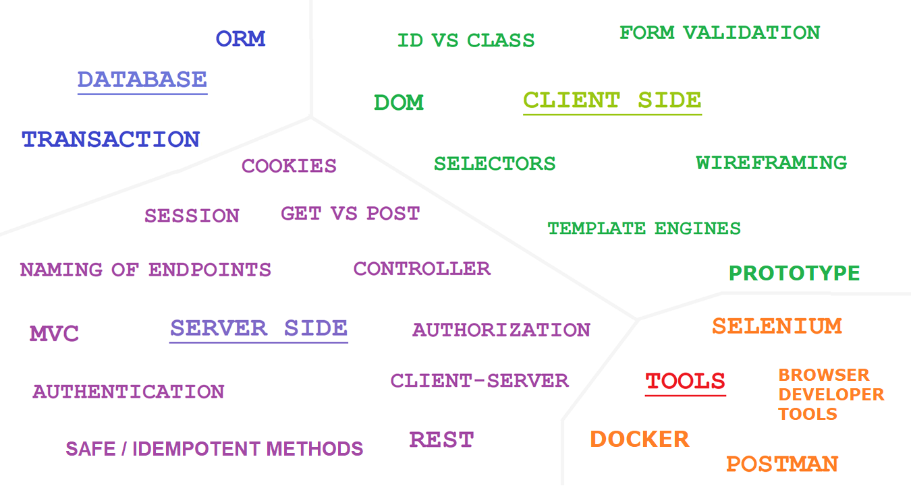

Slide 7
REST methods - overview
REST (Representational State Transfer) - an architectural style defining constraints to be used for web services.
REST principles:
Uniform interface,
Client – server separation,
Stateless,
Cacheability,
Layered system,
Code on demand.
REST != HTTP

Slide 8
REST methods - overview
Example REST methods:
GET – fetch data from database – e.g., show details for certain book or search book by title,
POST – add new data to database – e.g., new book in library,
PUT – update information in database – e.g., edit data for certain library user,
DELETE – remove data from database – e.g., delete library user.

Slide 9
GET VS POST
GET method is used for retrieving certain resources.
It is safe / read-only operation,
POST method is used for creating new resources,
POST method should be used when sending confidential data (login/password) as it is more secure,

Slide 10
GET VS POST
TOPIC | GET | POST
Can be cached? | YES | NO
Can be bookmarked? | YES | NO
Limited size of data | YES | NO
Security | Less secure, | More Secure
Is method safe ? | YES | NO
Is method idempotent ? | YES | NO
Visibility | Data visible in URL | Data hidden,

Slide 11
WHAT IS IDEMPOTENT OPERATION?
Operation is idempotent if it will give the same result if performed once or multiple times.
For example – checking bank account balance is idempotent, we will get the same result.
Withdrawing money is not idempotent – our balance changesevery time we take money,

Slide 12
IDEMPOTENCE - EXAMPLES
Multiply number by 1 ( x*1 )
Assigning variable ( variable = 100 )
Add zero to certain number ( x + 0 )
Absolute value ( |x| )
Eat one piece of a cake <not idempotent>
Delete specific row from database,
Check bank account balance,
Withdraw 2000$ from bank account - <not idempotent>

Slide 13
REST: IDEMPOTENT METHODS
GET
HEAD
OPTIONS
PUT
DELETE
POST
PATCH

Slide 14
REST: SAFE METHODS
HTTP methods are considered safe if they do not change the server state.
In other words: safe methods do not modify resources (they are read-only).
For example using GET or HEAD on a resource url we should never change the resource data.

Slide 15
REST: SAFE METHODS
GET
HEAD
OPTIONS
PUT
DELETE
POST
PATCH

Slide 16
REST – NAMING OF ENDPOINTS
https://book-rental/books/authors
http://book-rental/book-management/
Use nouns to name URIs,
Separate words with hyphens,
Use lowercase letters,
Use clear, intuitive names,
Use plural nouns (to avoid ambiguity),
Avoid special characters,

Slide 17
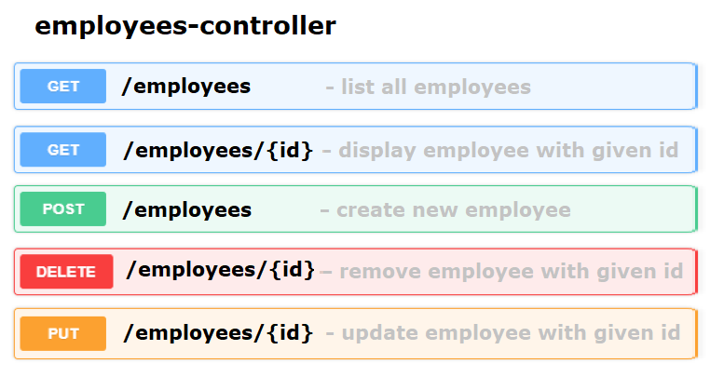
REST ENDPOINTS

Slide 18
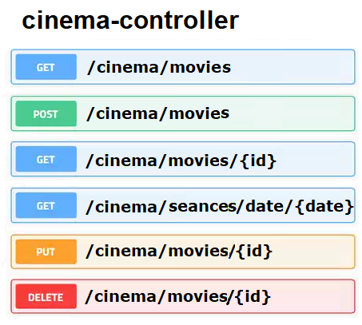
REST ENDPOINTS

Slide 19
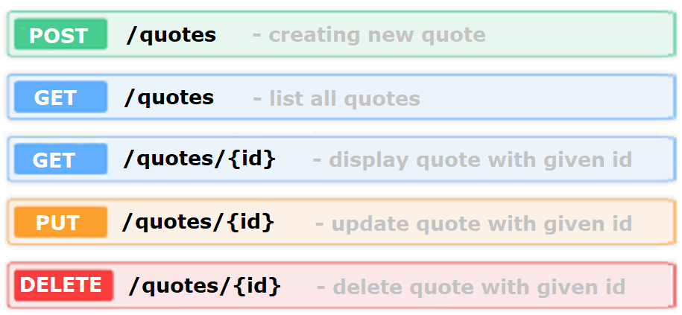
REST ENDPOINTS - DESIGN

Slide 20
ENDPOINTS
Of course, our URLs can have multiple parameters:
/users/{userId}/cars/{carId}
/users/12454/cars - list with cars that belong to user with id '12454’
/users/12454/cars/1233 - display the information of car '1233' which owner is user with id '12454'
/users/12454/groups - list with groups where certain user belongs to,

Slide 21
Model –View –Controller

Slide 22
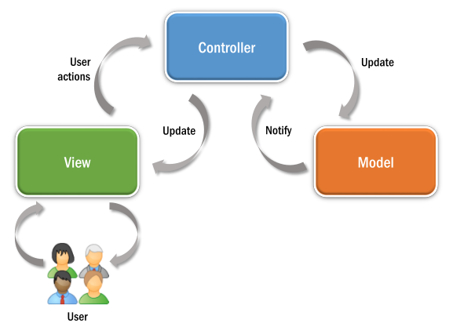
Model-View-Controller
MVC, or Model-View-Controller, is a software architectural pattern commonly used in the development of web applications. It divides an application into three interconnected components.
This separation makes the code more modular, maintainable, and scalable because changes in one component do not impact the others. MVC is widely used in many software development frameworks (especially for web development frameworks)
(
Source: https://upload.wikimedia.org/wikipedia/commons/thumb/7/7a/Model-View-Controller_architectural_pattern.svg/800px-Model-View-Controller_architectural_pattern.svg.png?20190801172842

Slide 23
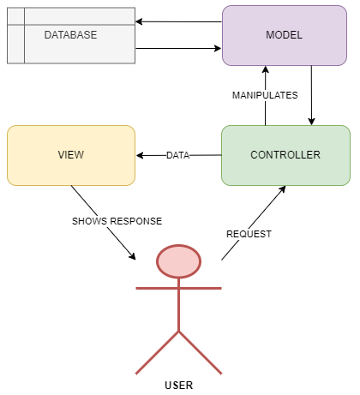
MVC - Controller
Controller - in web applications, the controller plays the role of an intermediary between the model and the view. It receives user input, processes it, updates the model if necessary, and then updates the view to reflect the changes.
The controller manages the flow of data between the model and the view, helping to maintain separation of concerns and making the application more modular and maintainable.
(

Slide 24
MVC - View
View - represents the user interface and presentation layer. It displays information to the user and sends user input to the controller for processing.
(

Slide 25
MVC - Model
Model represents the data and business logic of the application.
It is responsible for managing the data, processing user inputs, and responding to requests from the view.
(

Slide 26
Designing application

Slide 27

About our example application
Our example application
Book Rental is designed for librarians, and it is supposed to be used in small libraries. It helps with managing the process of renting books to readers.
Source: https://www.rawpixel.com/image/7419720/vector-book-public-domain-illustrations

Slide 28
DESIGNING WEB APPLICATION
User Roles,
Use Cases & Scenarios,
Items/Object in real world,
Planning Endpoints (URLs)
Views: Subpages / Forms in app,
Flow between pages,

Slide 29


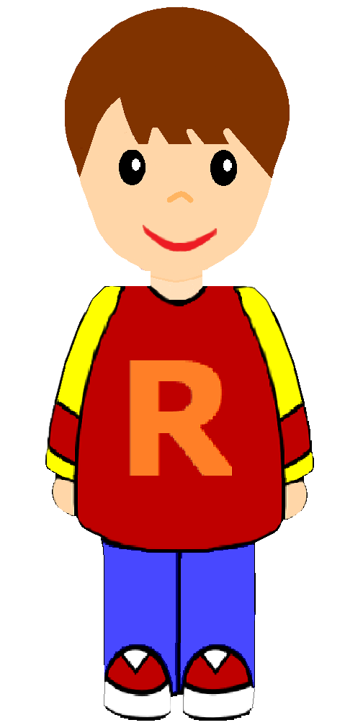
Source https://openclipart.org/detail/314949/librarian-2
User Roles
Librarian
Reader

Slide 30

Librarian
Registering the new users,
Adding new books,
Editing data about books / readers,
Renting books to users,
Checking how many books are rented by particular user,
Handling returned books in system.
Librarian

Slide 31
Reader
Searches available books in Library,
Checks which books are currently rented by him.
Reader

Slide 32
Items / Objects in system

Slide 33


Real–world objects
Library Card ID
123456
Book ID 379234
Library card ID
Book
RENTED

Slide 34
Book
Usually inside any library we have many books on the shelves,
Each book has unique book ID,
Each book has title and author.
Book ID 379234

Slide 35
Book
Other important properties are ISBN and year of publication,
Book can have a few categories (for example: novel, romance, horror, fantasy, science-fiction…),
Finding a particular book in big store might be difficult. To help Librarians with this task we added field shelf. This field represents physical location of book in library building.
Book ID 379234

Slide 36
Library card
Each user registered in library gets the printed document: “Library Card“,
Each Library CARD has unique ID,
The same ID is used in our system. Book Rental application identifies users by Library CARD ID.
Library Card ID
123456

Slide 37
Use cases

Slide 38
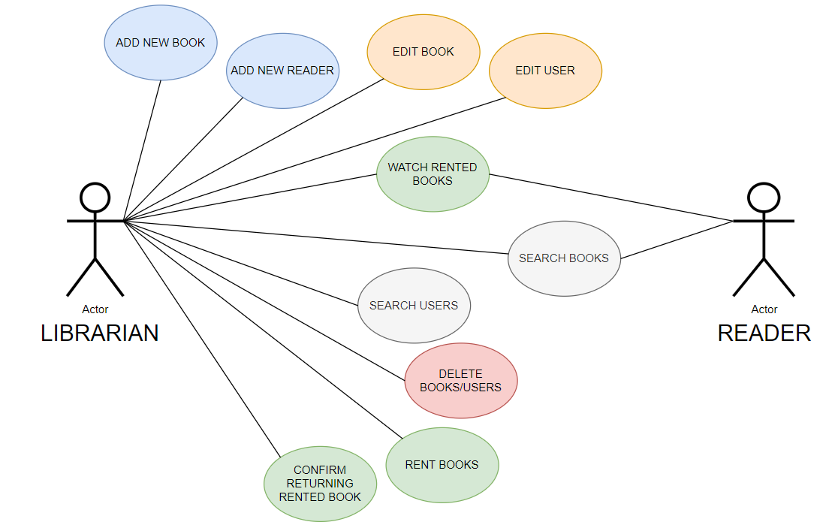

Slide 39
Wireframing

Slide 40
WIREFRAMING
A way of visualizing your future application.
Outline/draft/sketch of basic user interface for your website (views/subpages).
Wireframes can be drawn on paper or created digitally in some applications.

Slide 41
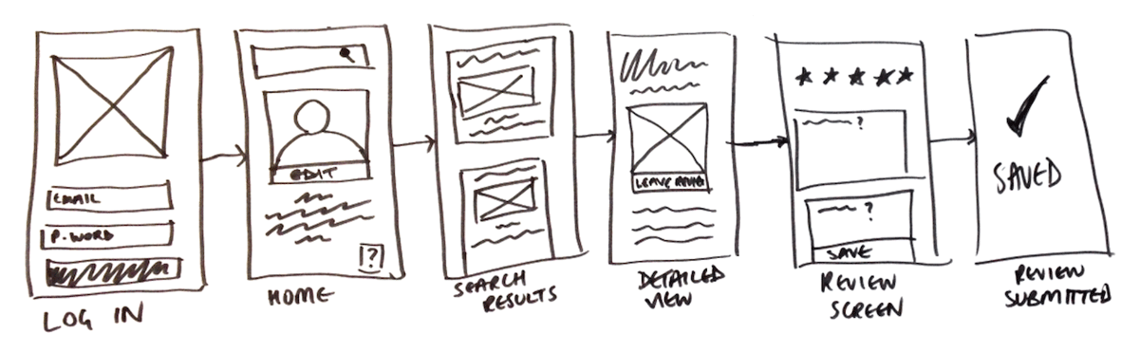
WIREFRAMING
Source: https://careerfoundry.com/en/blog/ux-design/what-is-a-wireframe-guide/

Slide 42
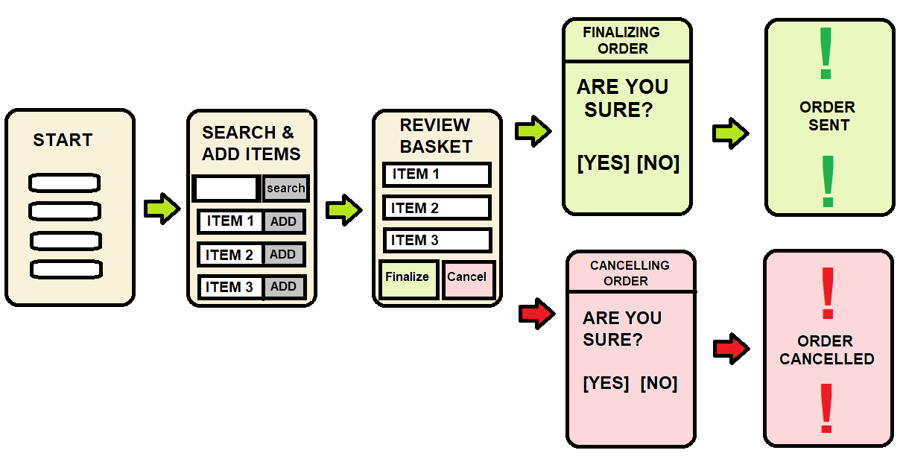
WIREFRAMING
pictureski
Source: https://www.towerhousestudio.com/blog/the-importance-of-wireframing-in-the-design-process

Slide 43
Scenarios

Slide 44
Yellow – activities in "real world", for example putting book on the shelf
White – virtual activities in Book Rental application

Slide 45
Scenario 1: Library bought a new book
<<INSIDE LIBRARY>>
Librarian starts the Book Rental application, logs in and clicks “Add New Book” button.
Librarian fills in the form and confirms operation. Book is added to the system.
Librarian puts the new book on the shelf.
Book ID 379234
Librarian

Slide 46
Scenario 2: New reader came to the library
<<INSIDE LIBRARY>>
New Reader arrived. The person wants to join library.
Librarian starts the Book Rental application, logs in and fills in the form “Add New User”. Unique ID is generated.
Library CARD ID is printed by Librarian. Document is given to the user.
Library Card ID
123456
Librarian
Reader

Slide 47
Scenario 3: Reader wants to rent a book
<<INSIDE LIBRARY>>
Reader comes in into the library building. Guest informs librarian about the book he wishes to rent.
Librarian searches book in System. The book is available.
Librarian takes the book from the shelf.
Librarian registers renting book in the system using ID of Library CARD showed by user.
Library Card ID
123456
Librarian
Reader
c

Slide 48
Scenario 4: Reader comes to library and returns book
<<INSIDE LIBRARY>>
Reader comes in into the library building and returns the book.
Librarian searches book in System and registers that the book is back.
Librarian puts the book on the shelf.
From now on other readers might borrow this book.
Library Card ID
123456
Librarian
Reader

Slide 49

Scenario 5: Pile of returned books, readers already left
<<INSIDE LIBRARY>>
In the morning many readers came to the library building. Librarian was very busy...
In meanwhile a few readers put their books on the table and left the library.
Now, we have a pile of returned books,
One by one book, Librarian opens the books and finds the rubber stamp with book id,
For each book librarian finds record in the system under "Rented Books" and clicks "Return Book" button.
Librarian

Slide 50
Scenario 6: Reader logs in to Rental App from home,
<<ONLINE>>
Reader needs certain book for his university work.
Reader logs in to the system,
Reader goes to "Search Book" and types the query.
System displays the information about the desired book.
Book is available in the library and not rented, so user will visit the building in person,
Reader

Slide 51
Limitations
c

Slide 52

Limitations
Sometimes we cannot handle all possible situations,
We need to think about limitations of our program – whicj scenarios will not be supported,
c

Slide 53
Endpoints naming

Slide 54
REST URLs/Endpoints naming – Nouns,
URL / ENDPOINT | HTTP METHOD | ACTION
/users | GET | List with many users,
/users | POST | Adding new user,
/users/{id} | GET | Details page for one user having certain ID,
/users/{id} | PUT | Updating one user having certain ID,
/books | GET | List with many books,
/books | POST | Adding new book,
/books/{id} | GET | Details page for one book having certain ID,
/books/{id} | PUT | Updating one book having certain ID,
/rented-books | GET | List with many books that are rented,
/books-rented-by-user/{userId} | GET | List with many books rented by certain user (user has certain userId)

Slide 55
Forms / Views

Slide 56
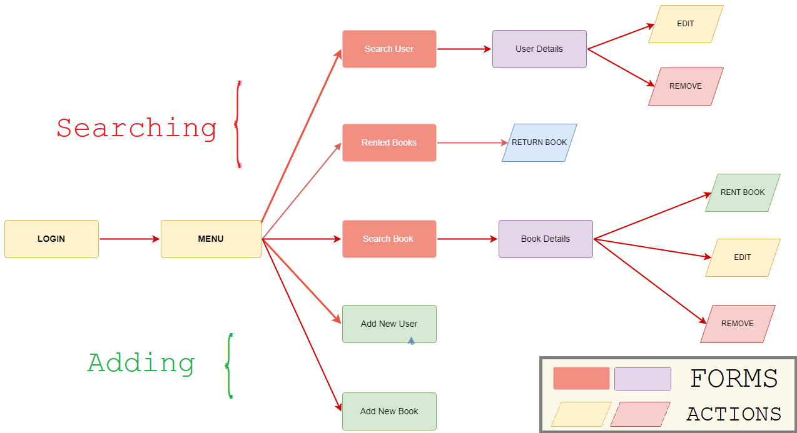

Slide 57
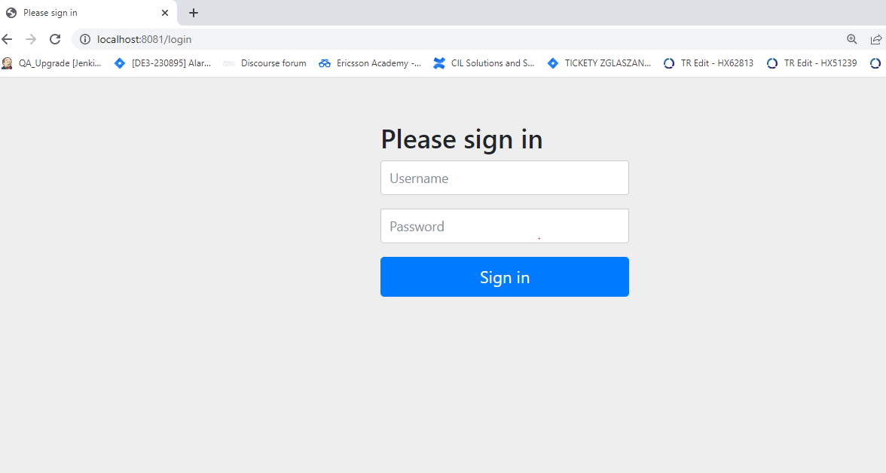
c

Slide 58
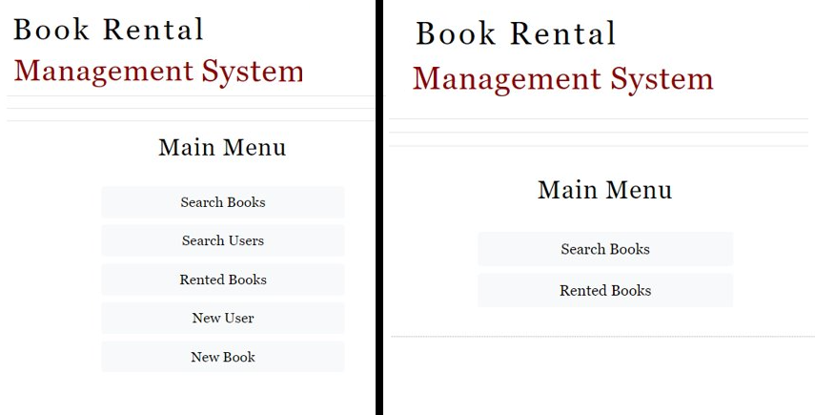
Menu for Librarian vs Menu for Reader

Slide 59
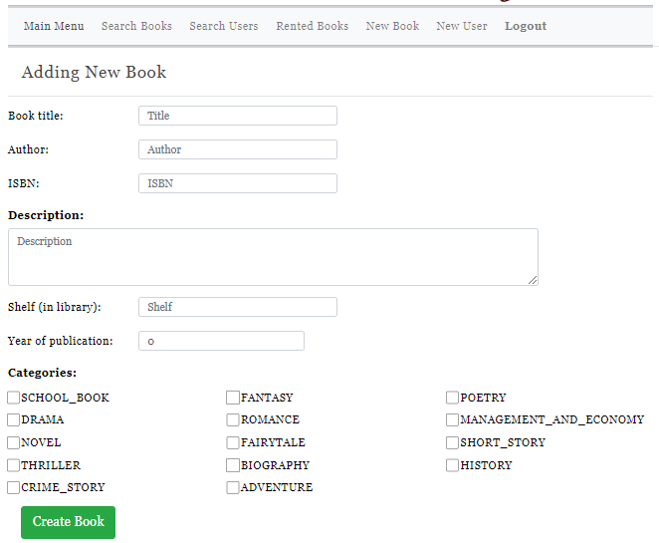

Slide 60
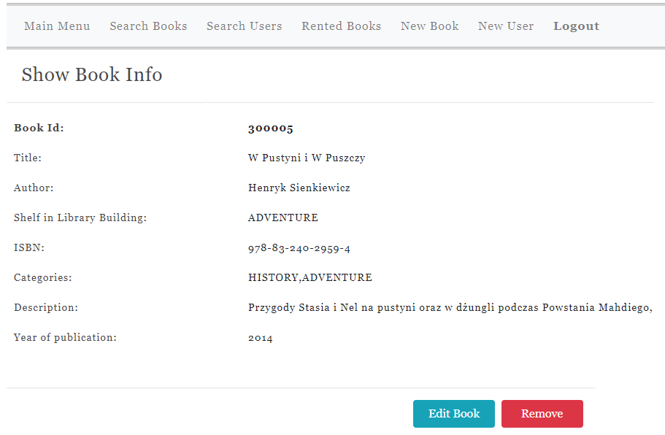
c

Slide 61
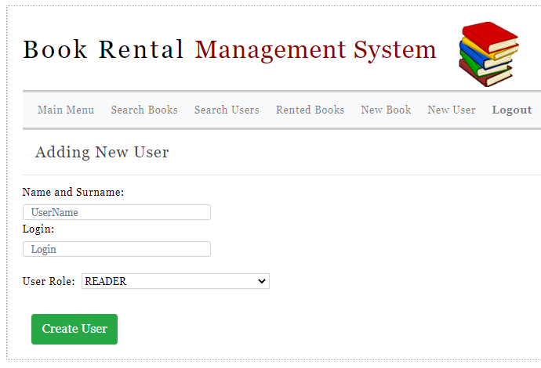
c

Slide 62
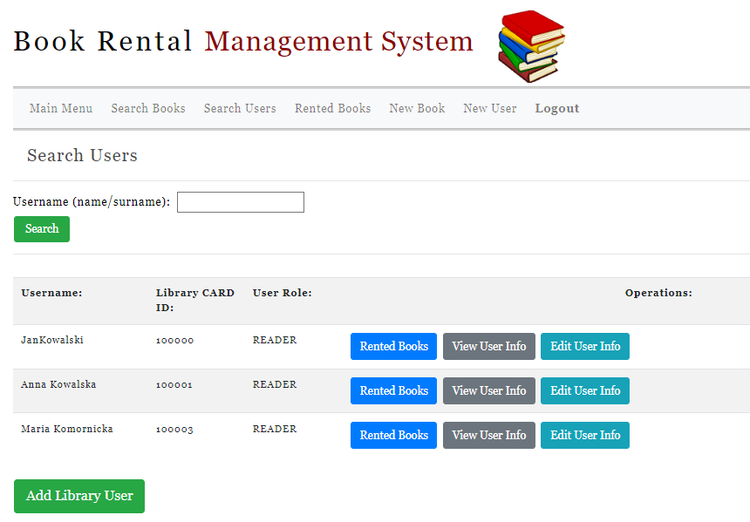
c

Slide 63
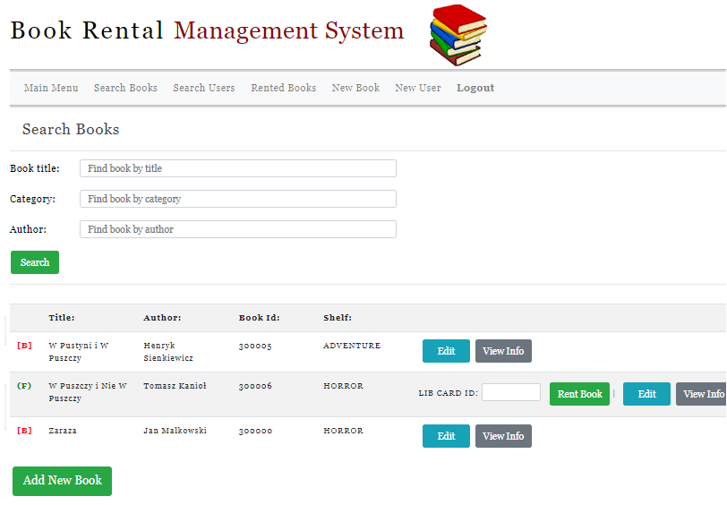
c

Slide 64
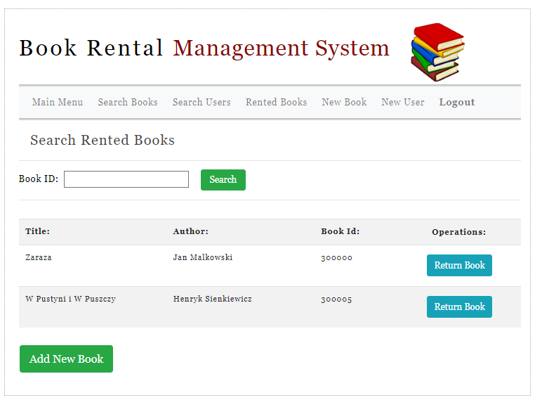
c

Slide 65
Prototype

Slide 66
Prototype
Usually it is better to show something than just talk,
Visualization helps our clients with understanding our concepts,
It is good to start developing your application as prototype with limited functionality. Then, your stakeholders can comment your vision on early stages.
We can design dummy application using frontend technologies (HTML, Bootstrap, Javascript)
c

Slide 67

Useful Tools

Slide 68
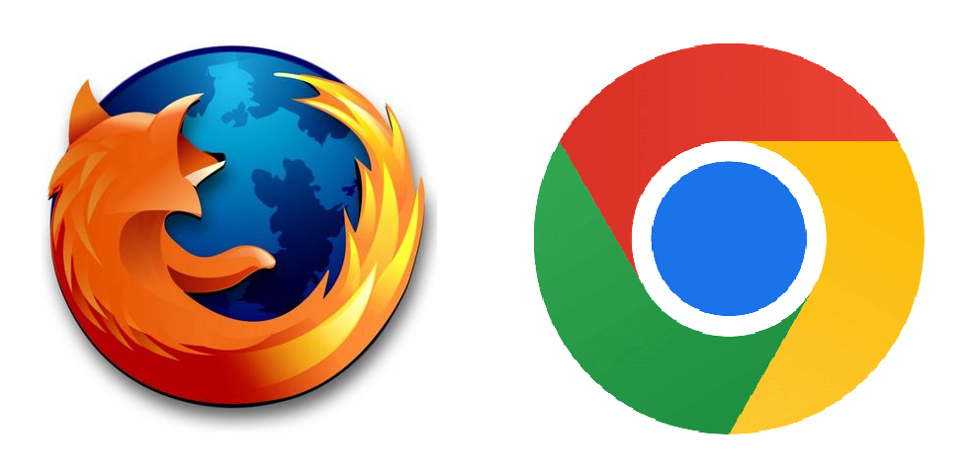
Developer Tools – Web Browsers

Slide 69
WEB BROWSER DEVELOPER TOOLS
What can we do using Developer Tools?
1) Modifying the look of elements (css style),
2) Finding elements on page,
3) Debugging javascript code,
4) Calling javascript code,
5) Network: checking what data was sent/received (HTTP requests for example JSON messages),

Slide 70
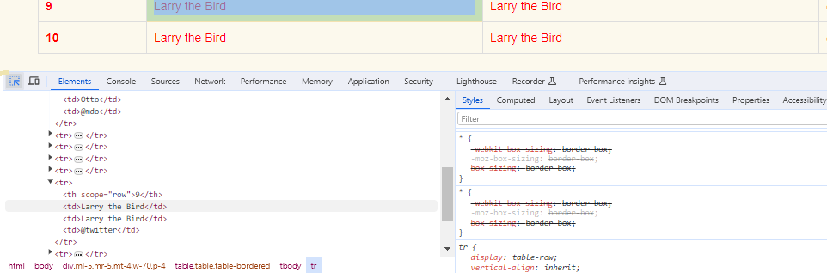
DEVELOPER TOOLS - INSPECT

Slide 71
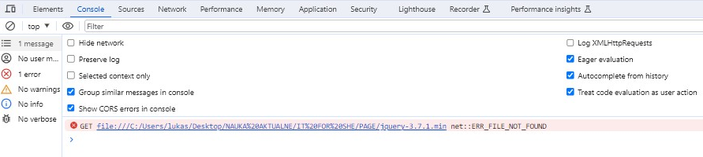
DEVELOPER TOOLS - CONSOLE

Slide 72
DEVELOPER TOOLS - NETWORK
We can check what kind of requests/responses were sent:
GET/POST calls, endpoints,
JSON data,

Slide 73
DOCKER

Slide 74
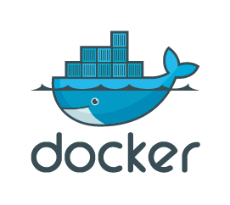
provides resources to run your application

Slide 75

What is a docker ?
Docker is one of the most popular platform for developing, shipping, and running applications.
Docker enables you to separate your applications from your infrastructure so you can deliver software quickly.
With Docker, you can manage your infrastructure in the same ways you manage your applications.
By taking advantage of Docker's methodologies for shipping, testing, and deploying code, you can significantly reduce the delay between writing code and running it in production.

Slide 76
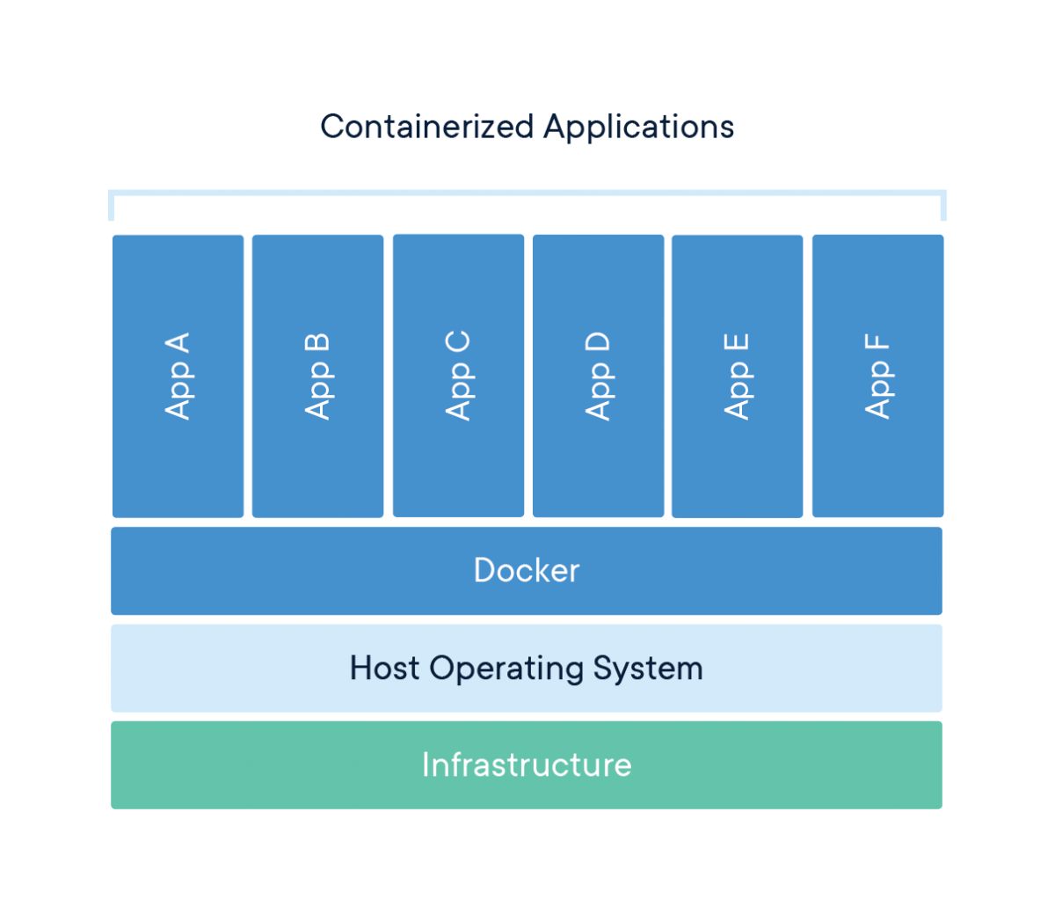
What is dockerization ?
Dockerization is the practice of bundling an application and its dependencies into a standardized container.
Containers wrap both the application and its dependencies, guaranteeing uniform and repeatable deployment in various environments.
source : https://commons.wikimedia.org/wiki/File:Docker-containerized-and-vm-transparent-bg.png

Slide 77
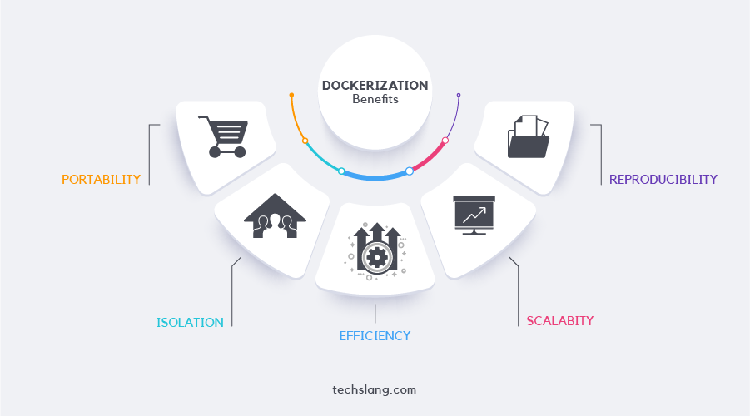
source : https://www.techslang.com/definition/what-is-dockerization/

Slide 78
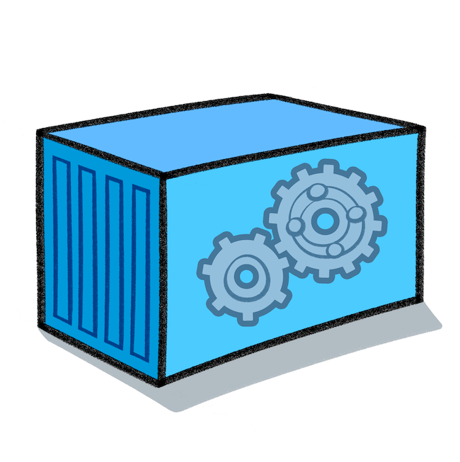
Docker - containers
In short, a container is an independent entity placed on a small part of our hard drive.
This part of the disk contains files required for the proper launch and operation of the application/program/process.
It depends on what's in the container.
Each container gets some hardware from our machine just for its own use (disk, RAM, network, etc.). Thanks to this, the containers are completely independent of each other and the host computer.

Slide 79

Docker - images
An image is a collection of software that runs as a container, containing a set of instructions for creating a container that can run on Docker.
Images are like compact packages that contain everything an application needs to run: code, libraries, and dependencies. They serve as a portable, consistent unit, ensuring the application runs reliably across different environments. Docker images streamline the deployment process and enhance scalability by isolating applications and their dependencies in a standardized way.

Slide 80
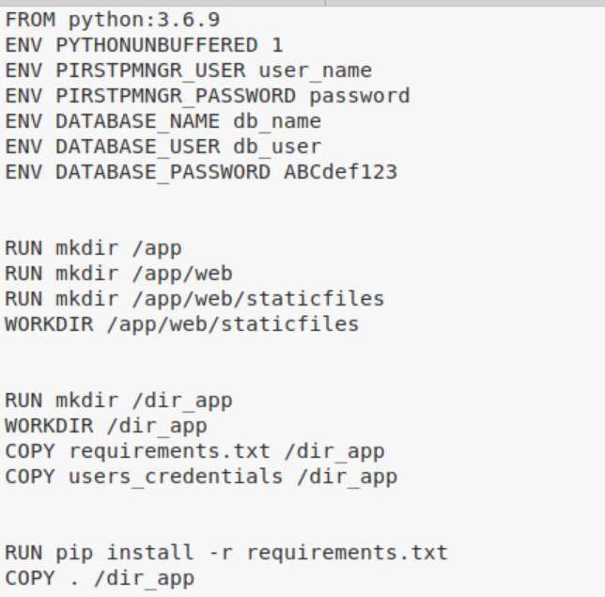
Docker – creating images
Dockerfile is a simple script that tells Docker how to build a Docker image. It specifies the steps to create the environment needed for your application to run. In essence, it's a set of instructions for Docker to follow when assembling. an application's container.
Dockerfile example

Slide 81
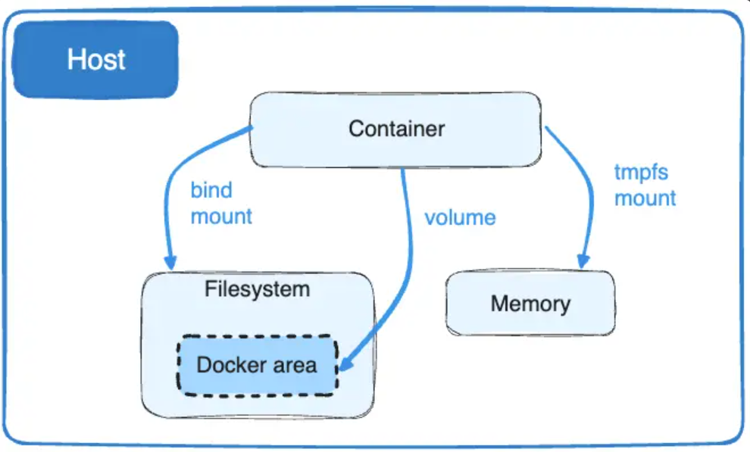
Docker - volumes
Volumes - allows us to map directories between the container and the machine on which Docker is running.
They are fully created and managed by Docker.
Each new volume is stored on the host disk.
This means that if the container is killed, our data will not be affected. It is worth noting that the volume data is completely isolated from the host system because it is managed by Docker.
Once a volume is created, it can be used by many containers at the same time.
source: https://docs.docker.com/storage/volumes/

Slide 82
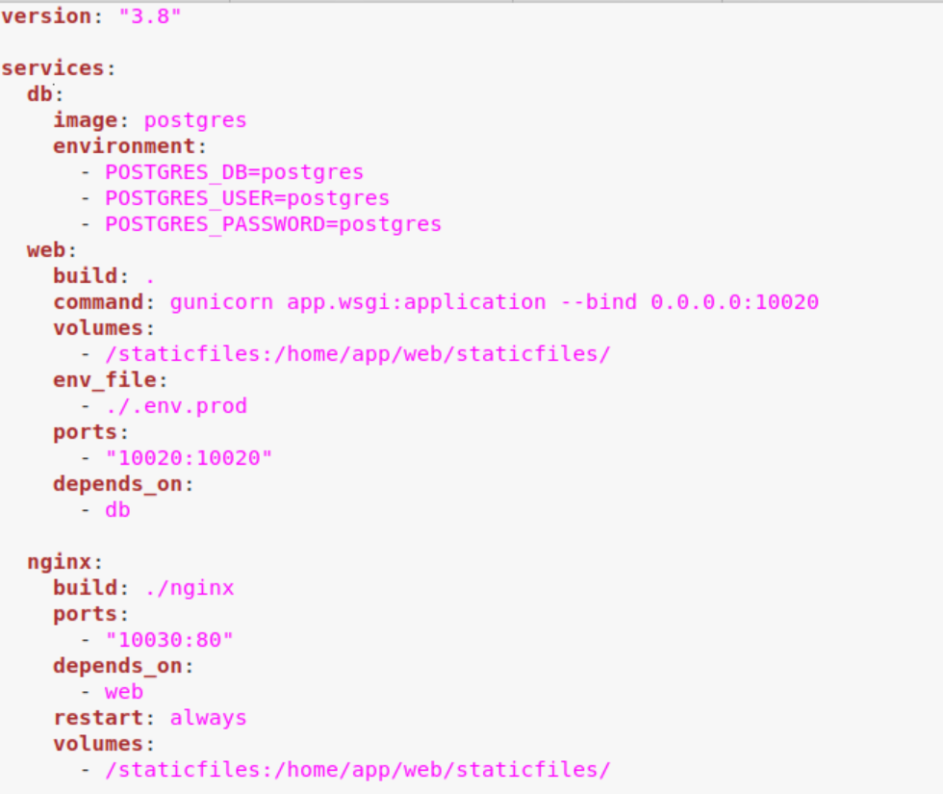
Docker-compose
Docker Compose is a tool that lets you define and manage multi-container Docker applications. It uses a simple YAML file to configure the services, networks, and volumes for your application.
Essentially, Docker Compose simplifies the process of running and connecting multiple Docker containers, making it easier to manage complex applications with multiple components.
Docker-compose example

Slide 83
Implementation - Backend

Slide 84
SERVER TECHNOLOGIES
Python
Django,
Javascript:
- NodeJS,
JAVA:
Spring,
Spring Boot,
JSF
PHP:
- Symfony,

Slide 85
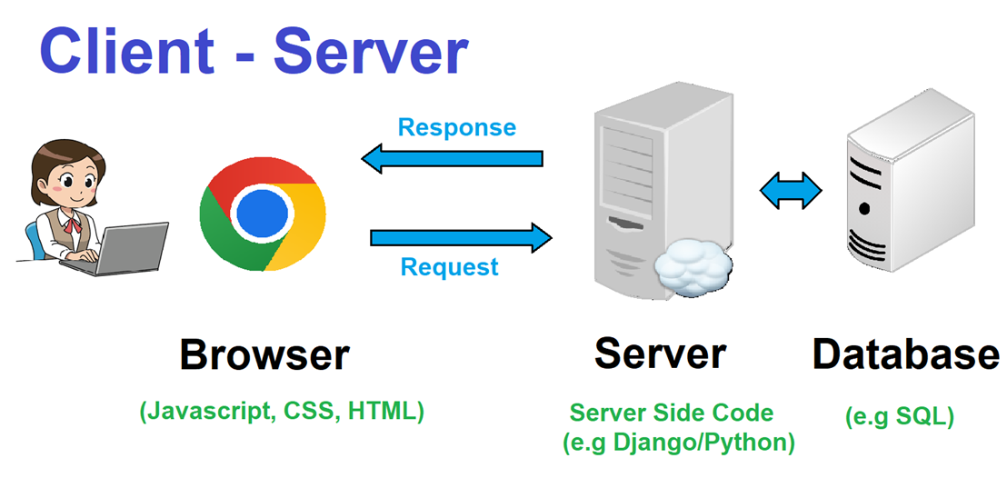
Created Image uses following images: https://openclipart.org/detail/295783/business-man-working https://commons.wikimedia.org/wiki/File:Tower_torre_pc_clon_server.svg https://commons.wikimedia.org/wiki/File:Cloud_server.svg

Slide 86
DJANGO FRAMEWORK

Slide 87

(
framework that simplifies building application

Slide 88
Django Framework
Django is a high-level web framework for Python that follows the Model-View-Template (MVT) architectural pattern.
It simplifies web development by providing tools and conventions for common tasks, promoting code reusability, and emphasizing rapid development.
(

Slide 89
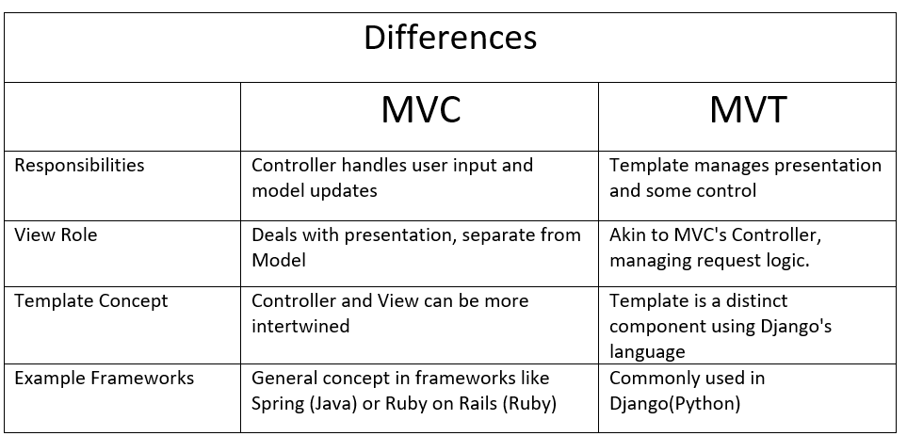
MVC vs MVT
(
In essence, MVT and MVC differ in how they handle presentation, control, and component organization

Slide 90
Django – creating a web application
1. Install Django using the command:
in the terminal, run : pip install django.
2. Create a Project:
In the terminal, run: django-admin startproject project_name.
3. Create an App:
In the terminal, create a new app: python manage.py startapp app_name.
4. Define Data Models:
In the app's models.py file, define data structures.
5. Generate migrations for the models:
In the terminal, run: python manage.py makemigrations.
(

Slide 91
Django – creating a web application
6. Apply migrations to create the database schema:
python manage.py migrate.
7. Create Views:
In the app's views.py file, define views for business logic.
8. Create HTML Templates:
Create a templates folder inside the app and place HTML files.
9. Configure URLs:
In the app's urls.py file, map URLs to views.
10. Run the Development Server:
Start the Django development server: python manage.py runserver.
(

Slide 92
Supporting Technologies

Slide 93


+
service and management of the web application

Slide 94
NGINX
Nginx is a high-performance web server and reverse proxy commonly used in web applications. It serves static content, acts as a reverse proxy to distribute traffic among multiple servers, and handles SSL/TLS termination.
Nginx improves application performance, scalability, and security by offering features such as caching, access control, and WebSocket support.

Slide 95
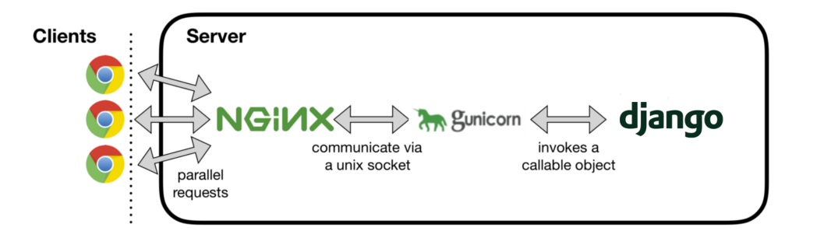
Gunicorn
Gunicorn is a WSGI (Web Server Gateway Interface) HTTP server for running Python web applications. It serves as a bridge between web frameworks (e.g., Flask, Django) and the web server, handling incoming requests and managing communication between the application and the server. Gunicorn is widely used in web applications to provide a reliable and efficient deployment solution for Python-based web services.
source : https://medium.com/analytics-vidhya/dajngo-with-nginx-gunicorn-aaf8431dc9e0

Slide 96

Frontend

Slide 97
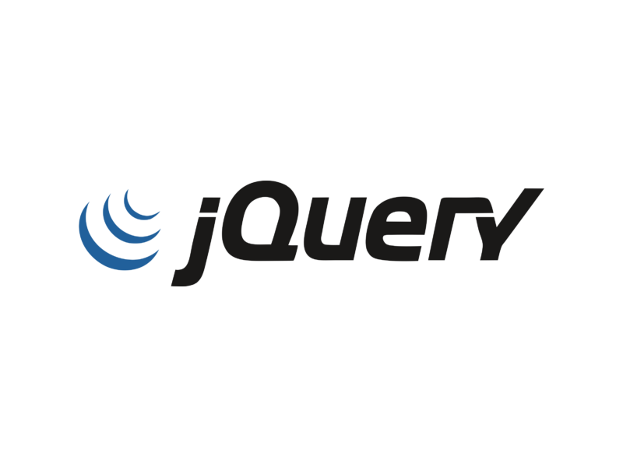
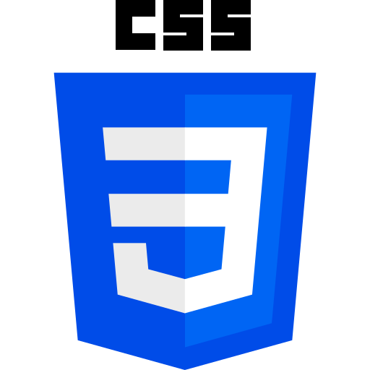
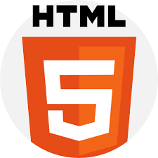
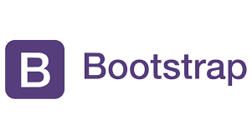
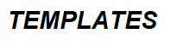
Technologies used for frontend

Slide 98
Bootstrap
is open-source front-end development framework for the creation of websites and web apps.
Bootstrap simplifies creating responsive, mobile-first front-end programs.
Bootstrap help us with appearance of our applications.
Bootstrap uses HTML, CSS, and JavaScript.
Bootstrap has ready solutions for many elements: buttons, alerts, modals, tabs, navigation bars, toolkits, dropdowns and many more…

Slide 99
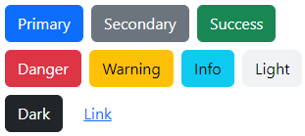
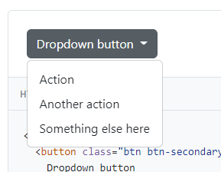
Bootstrap

Slide 100
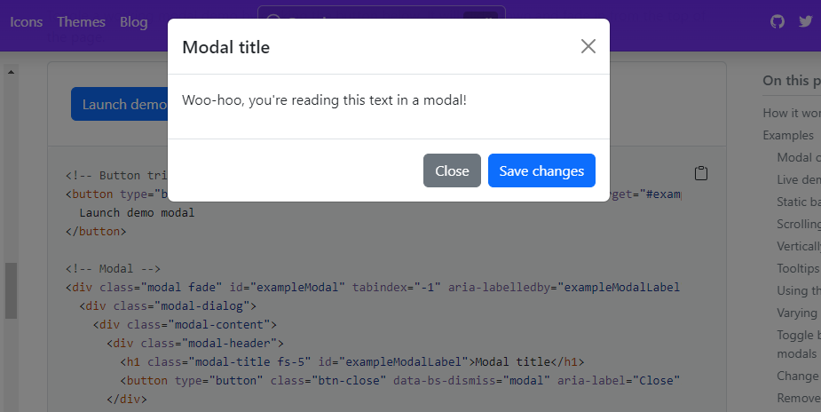
Bootstrap

Slide 101

JQuery
is a feature-rich JavaScript library.
It simplifies operations like: manipulation of HTML document (DOM operations), animations, event handling, AJAX.
Usually, no changes in HTML tags are required.
In our Book Rental application JQuery helps us with form validation on client side.

Slide 102
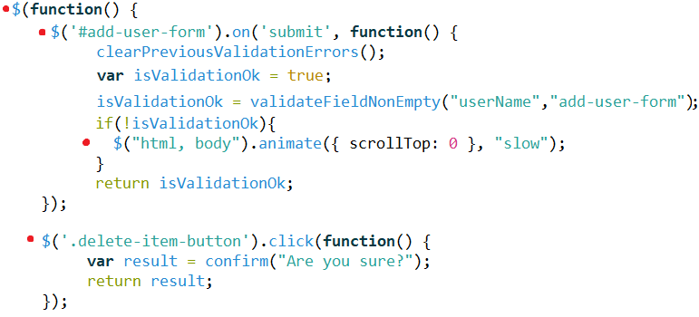
JQuery example

Slide 103
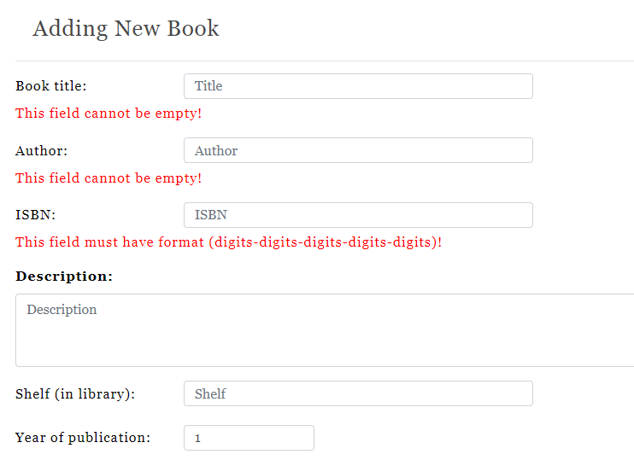
JQuery validate form

Slide 104
Validation - question
Is client-side validation sufficient for security (for example Javascript validation)?
Do we need server-side validation ?

Slide 105
Validation - question
The answer is “NO” !
Client side validation can be easily bypassed!
Malicious input can be submitted!

Slide 106
Questions

Slide 107
Bibliography
Images:
https://publicdomainvectors.org/pl/wektorow-swobodnych/Grafika-wektorowa-budynku-szko%C5%82y/11750.html
https://careerfoundry.com/en/blog/ux-design/what-is-a-wireframe-guide/
https://openclipart.org/detail/314949/librarian-2
https://freesvg.org/books
https://images.rawpixel.com/image_800/czNmcy1wcml2YXRlL3Jhd3BpeGVsX2ltYWdlcy93ZWJzaXRlX2NvbnRlbnQvbHIvam9iNjczLTE1OS14LmpwZw.jpg?s=l3MJkiQKcO5Q1lqiFPEpZn-HyL-CZmKAjsEnk9XR1bA
https://openclipart.org/detail/298193/librarian
https://freesvg.org/female-computer-user-vector-icon
https://www.rawpixel.com/image/7419720/vector-book-public-domain-illustrations

Slide 108
Bibliography (2)
https://www.freecodecamp.org/news/the-model-view-controller-pattern-mvc-architecture-and-frameworks-explained/
https://www.techslang.com/definition/what-is-dockerization/
https://medium.com/analytics-vidhya/dajngo-with-nginx-gunicorn-aaf8431dc9e0
https://docs.docker.com/storage/volumes/
https://www.google.com/url?sa=i&url=https%3A%2F%2Fopenclipart.org%2Fdetail%2F295783%2Fbusiness-man-working&psig=AOvVaw0GJqqPQuFHDBkfmOWh8_Up&ust=1701768583938000&source=images&cd=vfe&opi=89978449&ved=0CBMQjhxqFwoTCMjH-pC89YIDFQAAAAAdAAAAABAE
https://commons.wikimedia.org/wiki/File:Tower_torre_pc_clon_server.svg
https://commons.wikimedia.org/wiki/File:Cloud_server.svg
https://hub.docker.com/_/docker

